Slide 1
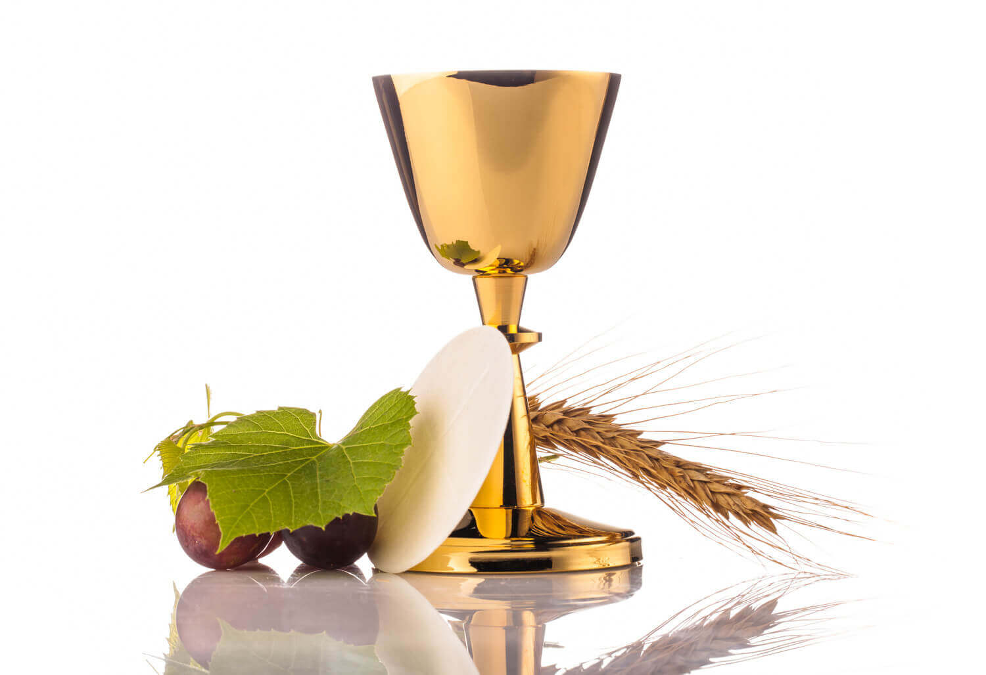
FANDRAISANA

